Slide 1


vs
Notes:
The proof our our effectiveness can be seen in our latest research where we analyzed over 300 million emails to determine the overall effectiveness.

Slide 2
Core Differences
Abnormal Security was founded in 2018. They tout an API-based solution with a simple 1-click installation procedure
Cloud-based mail environments like M365 and Google Workspace are their main thrust
Myopic focus on mail scanning, whose technology isn't truly inline nor preemptively focused. Huge emphasis is paid to two forms of phishing attacks: supply-chain attacks and BEC.
Does not support beyond the mailbox, so other parts of O365 and Google Workspace (e.g., file-sharing, Teams, etc.) are not scanned for complete protection
Notes:
The proof our our effectiveness can be seen in our latest research where we analyzed over 300 million emails to determine the overall effectiveness.

Slide 3
Core Differences
Avanan released a cloud-first architecture in 2015, securing O365 and G-Suite natively
Complete suite protection, support mail, file-sharing, Teams, and more
Native DLP support, which searches outbound mail for sensitive keywords and offers encryption capabilities
World's largest threat database makes AI the most comprehensive on the market
More than just supply-chain attacks and BEC: our 300 AI and ML models target all forms of contemporary attack
Notes:
The proof our our effectiveness can be seen in our latest research where we analyzed over 300 million emails to determine the overall effectiveness.

Slide 4
Primary Comparisons
Installation Time | 5 Minutes | 5 Minutes
Deployment Method | Inline API | API
Complete Inbox Protection | Yes | No
File-Sharing and Chat Support (OneDrive, Sharepoint, Google Drive, Dropbox, Box) | Yes | No
Granular Policies for Phish & Spam | Yes (Flexible actions like Quarantine, Send to Junk Folder, etc. for different groups) | No ("All or nothing", phish & spam get treated the same for everyone)
Search and Destroy for Emails | Yes (Millions of records at once) | Limited
Notes:
The proof our our effectiveness can be seen in our latest research where we analyzed over 300 million emails to determine the overall effectiveness.

Slide 5
Secondary Comparisons
Data Loss Protection Support | Yes | No
Incident Response as a Service (IRaaS) | Yes | No
Advanced Malware Sandboxing | Yes (Check Point Sandblast) | No
Basic Antivirus | Yes (via Checkpoint AV) | No
Outbound Email Encryption | Yes | No
Support for End-User Digests | Yes | No (Abnormal claims "no need")
Notes:
The proof our our effectiveness can be seen in our latest research where we analyzed over 300 million emails to determine the overall effectiveness.

Slide 6
Abnormal's Weaknesses
Notes:
The proof our our effectiveness can be seen in our latest research where we analyzed over 300 million emails to determine the overall effectiveness.

Slide 7
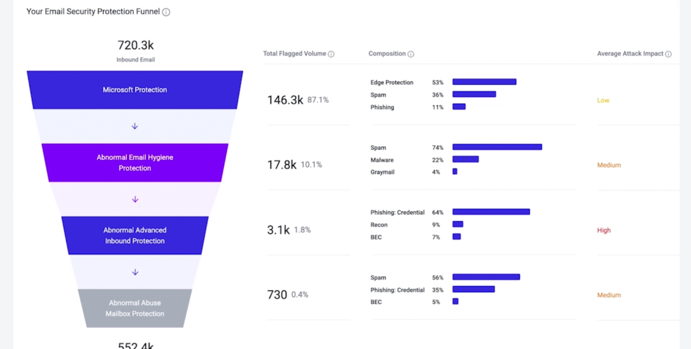
Limited to Email Support
Abnormal's AI is focuses on email only. What about file-sharing apps? And if we purely focus on email protection, in and of itself, Abnormal's AI provides no advanced malware facilities nor sandboxing techniques.
Notes:
The proof our our effectiveness can be seen in our latest research where we analyzed over 300 million emails to determine the overall effectiveness.

Slide 8
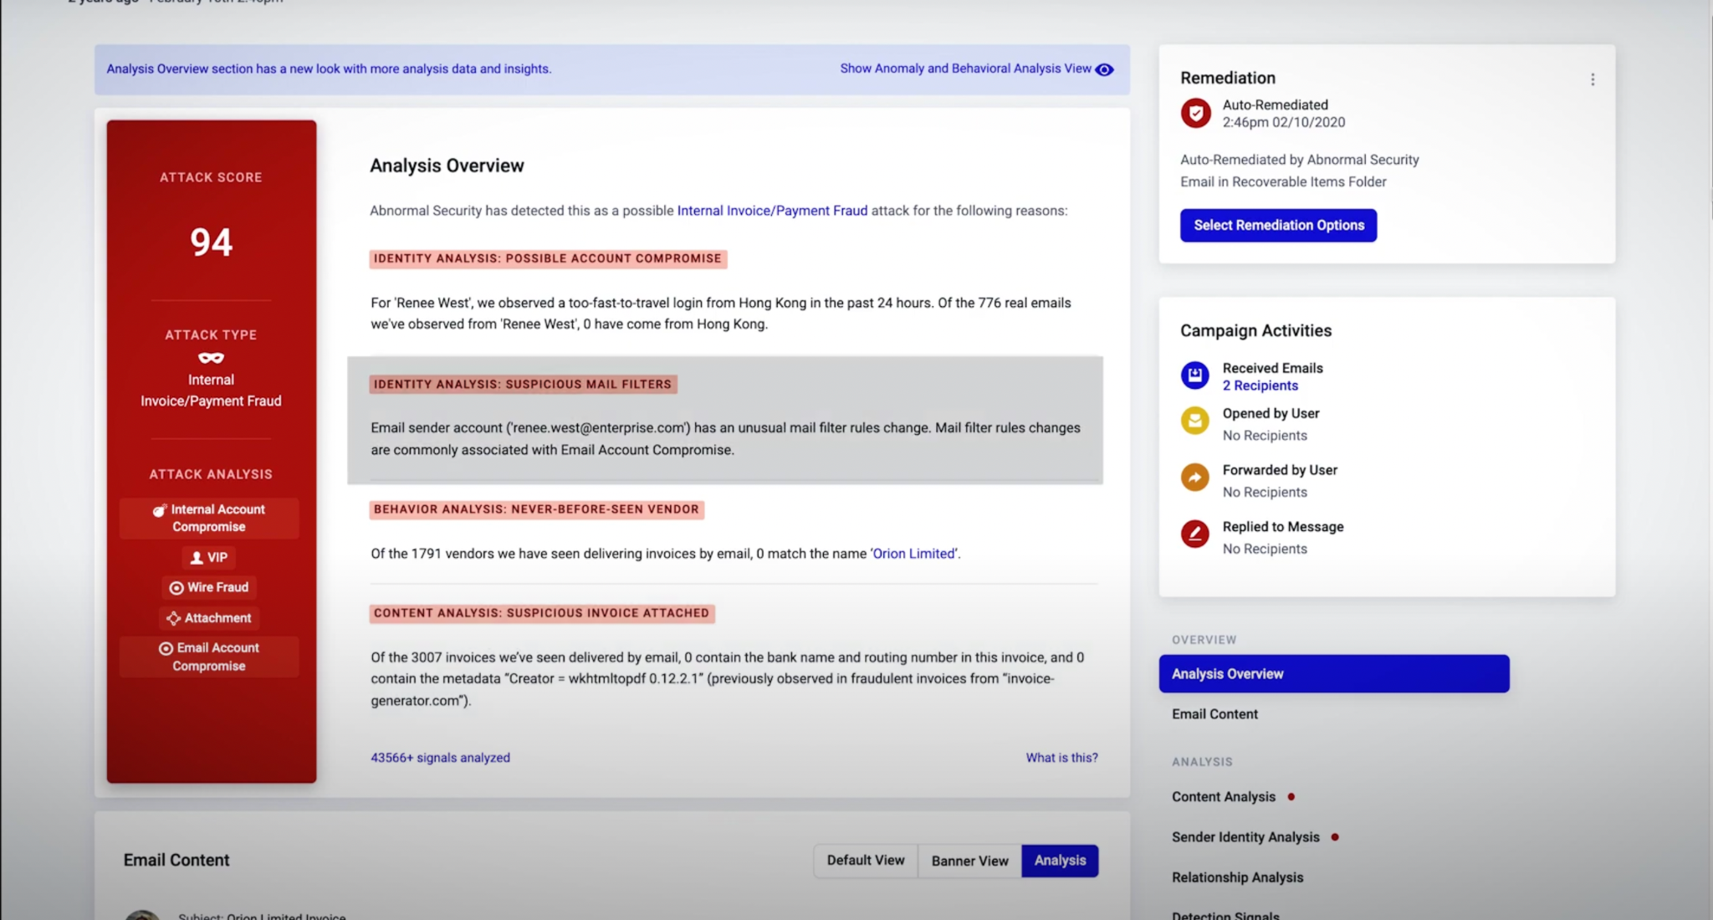
Weak-to-Little Malware Analysis
Although there's decent analysis as to what's phishy, there is no hinting of malware sandboxing. It's important to have reportability of files that can cause untold damages to the org. It seems malware is an afterthought here.
Notes:
The proof our our effectiveness can be seen in our latest research where we analyzed over 300 million emails to determine the overall effectiveness.

Slide 9
Pricing & Feature Comparisons
Notes:
The proof our our effectiveness can be seen in our latest research where we analyzed over 300 million emails to determine the overall effectiveness.

Slide 10
Pricing & Features
Malware Protection, Per User/Per Month | $4.60 | $3
Email Protection + Attachment Scanning | Yes | Yes
OneDrive Included? | Yes | N/A
SharePoint Included? | Yes | N/A
Google Drive Included? | Yes | N/A
Notes:
The proof our our effectiveness can be seen in our latest research where we analyzed over 300 million emails to determine the overall effectiveness.

